Slide 1
Simulated Autopoiesis in Liquid Automata
Steve Battle & Dan Brickley
UWE Bristol
Workshop on Liquid and Colloid Cybernetic Systems
4th July 2022, UWE, Arnolfini, Bristol

Slide 2
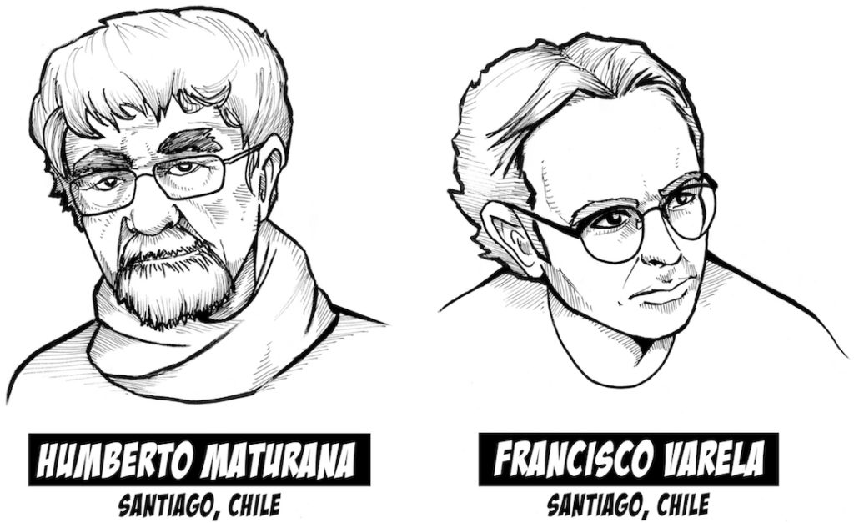
Living Machines
“A universe comes into being when a space is severed into two. A unity is defined.”
“An autopoietic machine is a machine organized (defined as a unity) as a network of processes of production (transformation and destruction) of components”
Humberto Maturana & Francisco Varela Autopoiesis and Cognition: The Realization of the Living (1972)

Slide 3
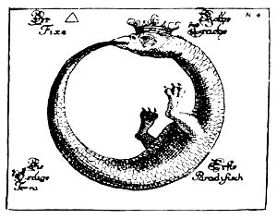
Autopoiesis
Organisational closure: A network of processes of self-production. eg. a chemical reaction system
Maintenance of Identity: The emergence of a homeostatically maintained boundary dividing self from non-self. eg. a cell-wall

Slide 4
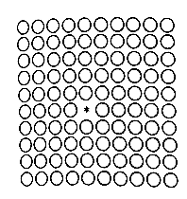
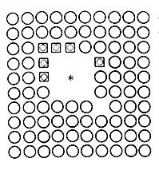
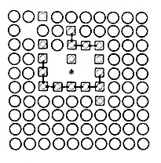
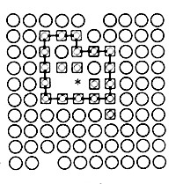
Varela’s Cellular Automaton*
1) Catalyst in a sea of substrate
2) Substrate fused into links
3) Bonds form
4) Boundary defines a unity
*Principles of Biological Autonomy (1979)

Slide 5
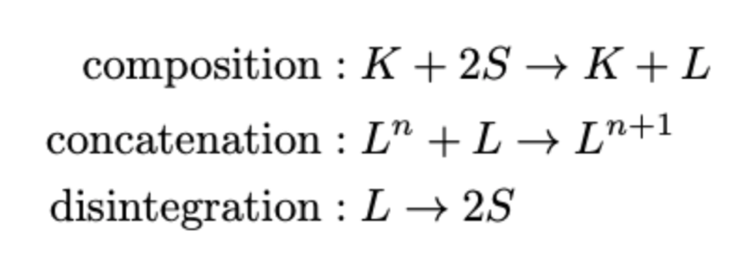
Reaction rules
Where:
S is the substrate (circles)
K is a catalyst (star)
L are links (squares)
Concatenated links (bonds) are shown as lines.

Slide 6
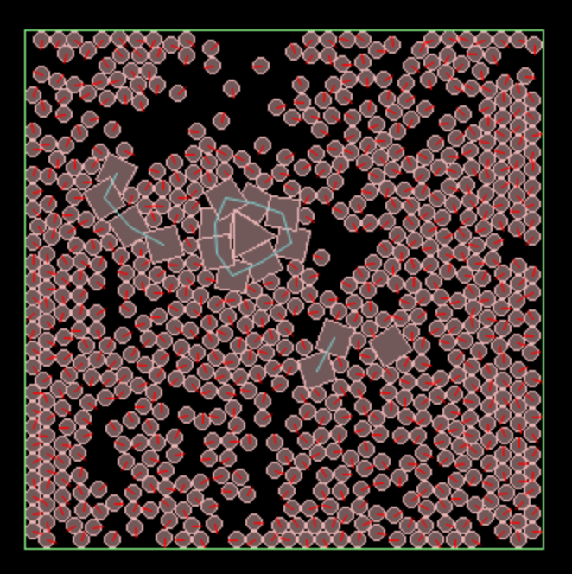
Liquid Automaton
L = (W, P, B, J, R)
where :
W is a world, with dimensions
P is a set of particle types with different shapes
B is a set of bodies, instances of particle types
J is a set of joints, that enable bodies to be bonded together
R is a set of reaction rules

Slide 7
Artificial Autopoiesis
Energy introduced as ‘Brownian’ motion.
Asynchronous, collision-based particle model.
Catalyst (triangle) feeds on substrate (circles) producing the structural building blocks, or links (squares).
Links (squares) self-organise into a compound structure (blue joints)
Closed boundary is formed, analogous to a cell wall, enclosing the catalyst.

Slide 8
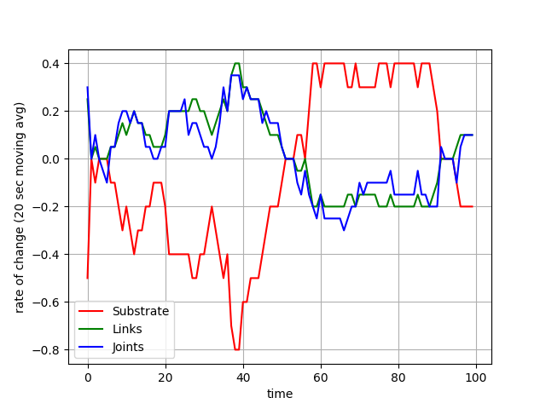
Rates of change
Rate of change of substrate and links are directly related: L = -2S
Each link can join up with two others forming a chain, so the number of links and joints are closely related.

Slide 9
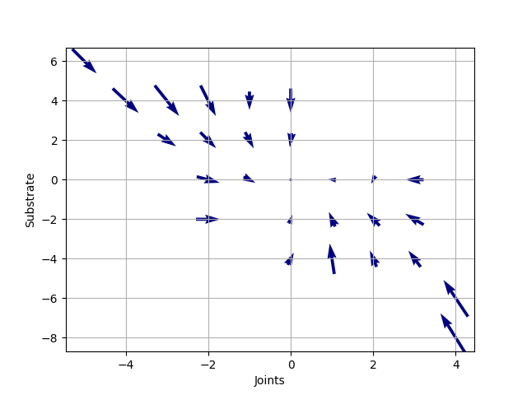
Phase diagram
Rate of change of joints (x) vs rate of change of substrate (y).
Dynamic equilibrium around 0,0
With more joints, fusion of substrate is throttled back, reducing joint formation.
As links decay into substrate, joints break, increasing the flow of substrate to the catalyst…

Slide 10
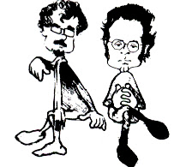
Conclusion
This is a Minimal Autopoietic Simulation, demonstrating organisational and structural closure.
Invites investigation of more interesting chemical reaction systems with more sophisticated metabolisms

